Slide 1
Cs-381 Software Engineering
Course Instructor: Dr. Shazia Arshad
Notes:
Welcome to all of you in this course. I am Dr. Shazia Arshad. I will be your instructor for this course.

Slide 2
What is SEQUENCE DIAGRAM??
Sequence diagrams, commonly used by developers, model the interactions between objects in a single use case.
They illustrate how the different parts of a system interact with each other to carry out a function, and the order in which the interactions occur when a particular use case is executed.
The sequence diagram is used primarily to show the interactions between objects in the sequential order that those interactions occur

Slide 3
Elements of Sequence Diagram
Lifeline Notations
Activation Bars
Message Arrows
Comments

Slide 4
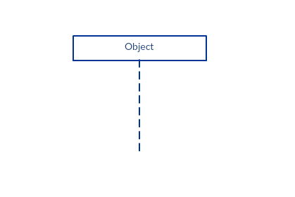
Lifeline Notations
A lifeline is a named element which depicts an individual participant in a sequence diagram.
They represent the different objects that interact with each other in the system.
They should be arranged horizontally across the top of the diagram.
No two lifeline notations should overlap each other.
Lifelines are shown as a box with a dashed line descending from the center of the bottom edge.
This dashed vertical line shows the sequential events that occur to an object during the process.
Lifelines may begin with a labeled rectangle shape or an actor symbol..
The standard in UML for naming a lifeline follows the following format – Instance Name : Class Name

Slide 5
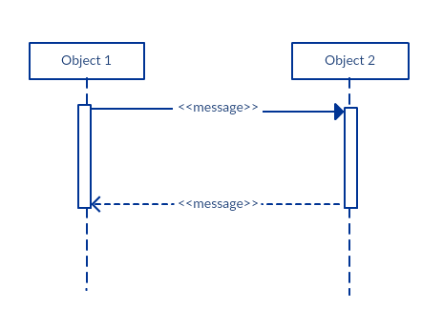
Activation Bars
Activation bar is the box placed on the lifeline
It indicates that an object is active (or instantiated) during an interaction between two objects
The length of the rectangle indicates the duration of the interaction.

Slide 6
Message Arrows
An arrow from the Message Caller to the Message Receiver specifies a message
The message can flow in any direction; from left to right, right to left and back to the caller itself
The description of the message should go on the arrow
Arrow heads may change according to different message types
Synchronous message, Asynchronous message, Return message
Participant creation message, Participant destruction message
Reflexive message

Slide 7
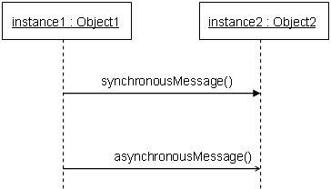
Message Types
A synchronous message is used when the sender waits for the receiver to process the message and return before carrying on with another message.
An asynchronous message does not wait for a reply from the receiver. The interaction moves forward irrespective of the receiver processing the previous message or not

Slide 8
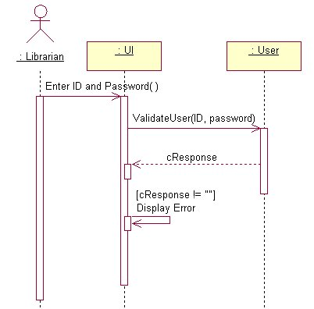
Message Types
A return message is used to indicate that the message receiver is done processing the message and is returning control over to the message caller.
When an object sends a message to itself, it is called a reflexive message. It is indicated with a message arrow that starts and ends at the same lifeline.

Slide 9
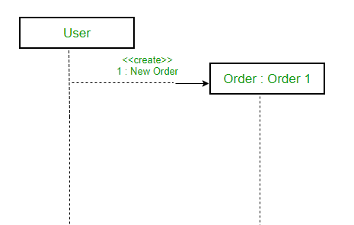
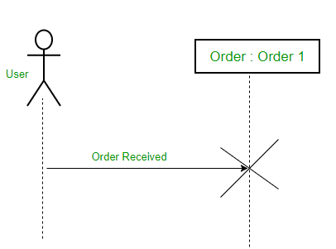
Message Types
Create message – We use a Create message to instantiate a new object in the sequence diagram. There are situations when a particular message call requires the creation of an object. It is represented with a dotted arrow and create word labelled on it to specify that it is the create Message symbol.
Delete Message – We use a Delete Message to delete an object. When an object is deallocated memory or is destroyed within the system we use the Delete Message symbol. It destroys the occurrence of the object in the system. It is represented by an arrow terminating with a “x”

Slide 10
How to create a sequence diagram?
A sequence diagram represents the scenario or flow of events in one single use case. The message flow of the sequence diagram is based on the narrative of the particular use case.
Before you start drawing the sequence diagram or decide what interactions should be included in it, you need to ready a comprehensive description of the particular use case.
Use case example – Create new online library account

Slide 11
Example (Create new online Library Account)
Step 1: Identify the objects or participants in the use case ‘Create New User Account’
Librarian
Online Library Management system
User credentials data base
Email system

Slide 12
Example (Create new online Library Account)
Step 2: List down the steps involved in the execution of the use case
The librarian requires the system to create a new online library account
The librarian selects the library user account type
The librarian enters the user’s details
The user’s details are checked using the user Credentials Database
The new library user account is created
A summary of the new account’s details is emailed to the user
Step 3: Identify which messages should be passed between the objects. Then draw the sequence diagram.

Slide 13
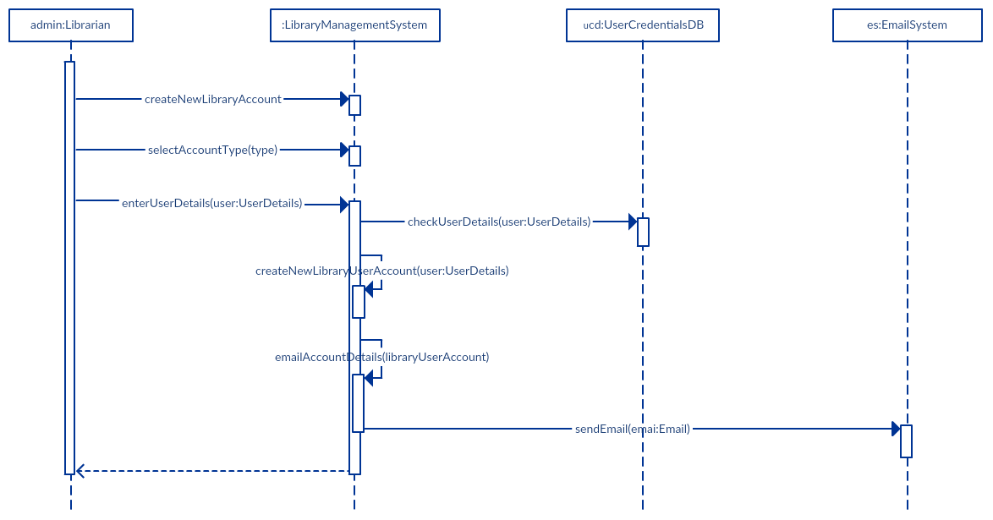
Example (Create new online Library Account)

Slide 14
Sequence Diagram Best Practices
Manage complex interactions with sequence fragments
Sequence fragments are used to show complex interactions such as alternative flows and loops in a more structured way.
A sequence diagram is drawn as a box that frames a section of interactions between objects in a sequence diagrams.
On the top left corner of the fragment sits an operator. This – the fragment operator - specifies what sort of a fragment it is.

Slide 15
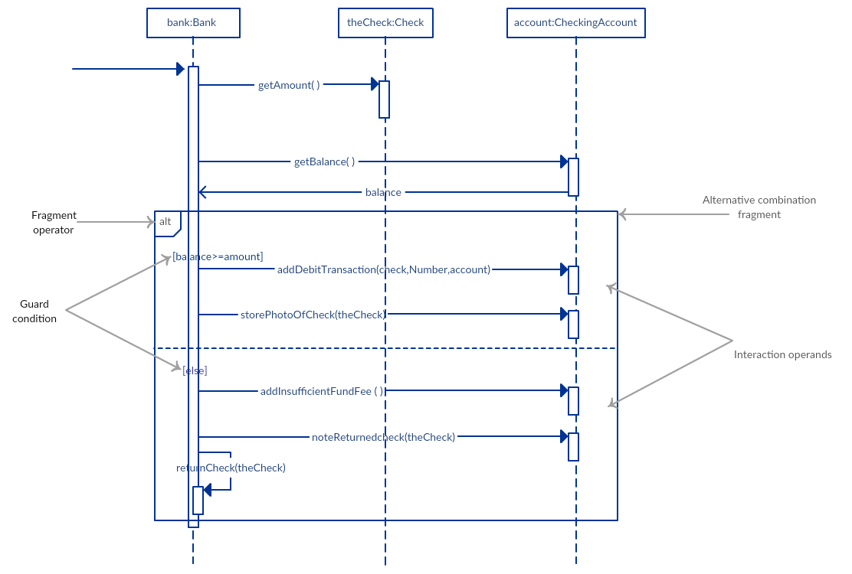
Alternative Combination Fragment
The alternative combination fragment is used when a choice needs to be made between two or more message sequences. It models the “if then else” logic.
To show 2 or more alternatives, the frame is divided into what is called interaction operands using a dashed line.

Slide 16
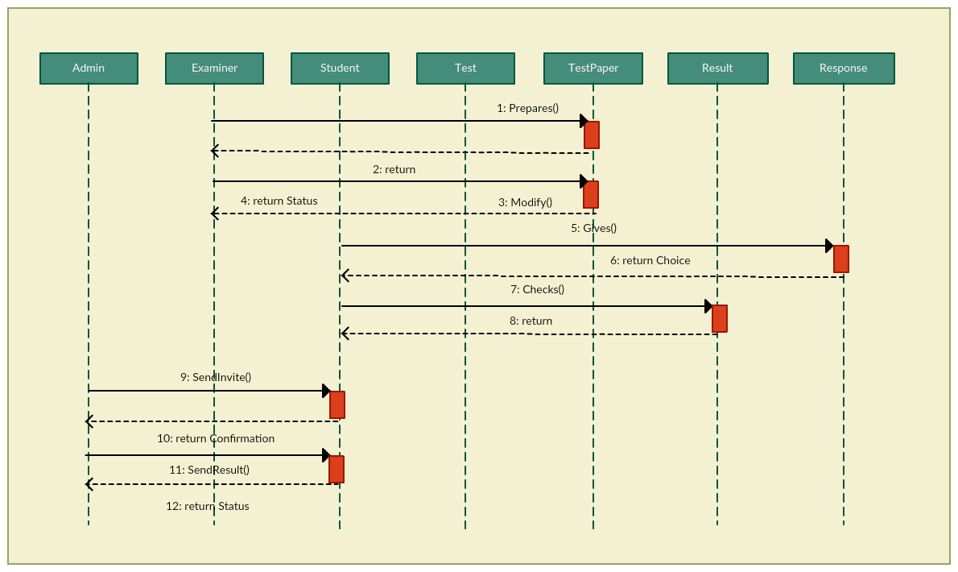
Example: Online Exam System

Slide 17

TIME TO THINK
Draw SEQUENCE Diagram for your project????

